Slide 1
2023 Executive Budget Presentation
J. Ryan McMahon, II, County Executive
Thursday, September 15th, 2022

Slide 2
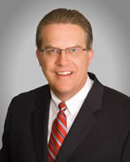
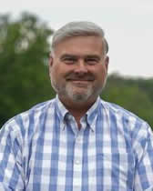
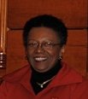
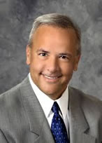
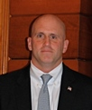
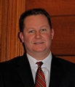
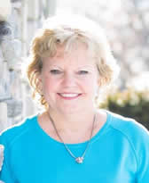
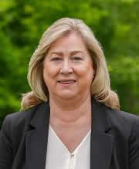
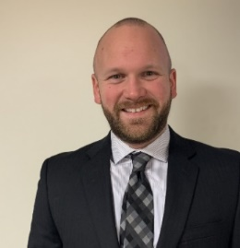
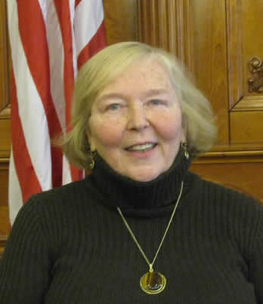
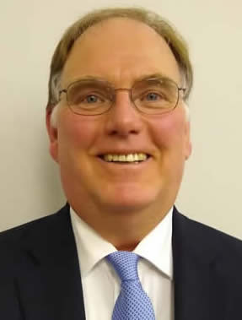
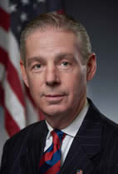
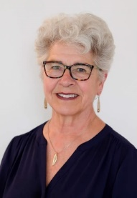
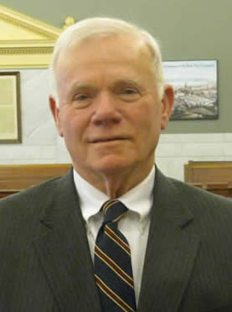
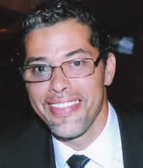
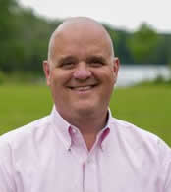
Onondaga County Legislature

Slide 5
2023 Executive Budget Presentation
J. Ryan McMahon, II, County Executive
Thursday, September 15th, 2022

Slide 6
2023 Executive Budget
·Statement of Values & Priorities
·Tax Relief
·Funds Base Operations
·Investments in Public Safety, Infrastructure & Neighborhoods
·Historic Investments in Our Kids

Slide 7
2023 Executive Budget
Fully Balanced
5th straight year without using general fund reserves

Slide 8
2023 Executive Budget
11%
Tax Cut
$4.79(2022)
$4.26(2023)
$100+ savings for homes assessed at $200k
*avg. assessed value in Onondaga County is ~ $200,000

Slide 9
Solid Fiscal Management
County Tax Rate per thousand since 2012
* proposed

Slide 10
Solid Fiscal Management

Slide 11
2023 Executive Budget Presentation
J. Ryan McMahon, II, County Executive
Thursday, September 15th, 2022

Slide 13
Fiscal Responsibility
Sales Tax Projections
2022 = 2% growth
2023 = 1% growth

Slide 14
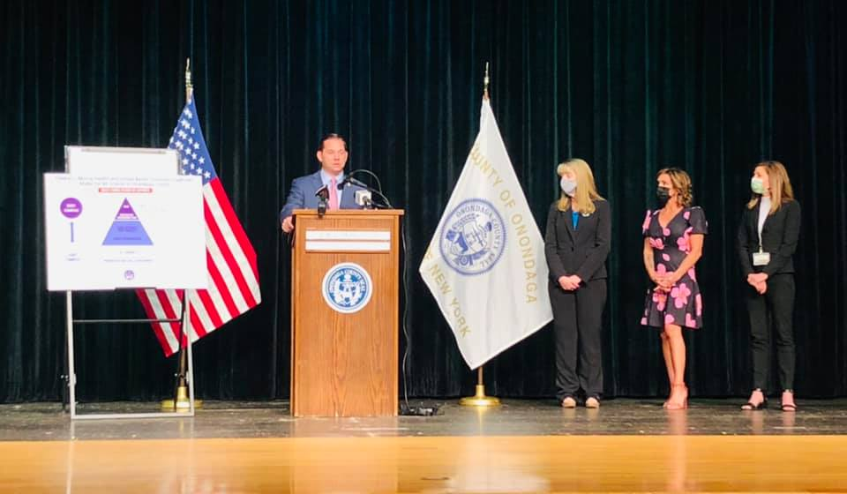
Strategic & Important Investments
$5.5M

Slide 15
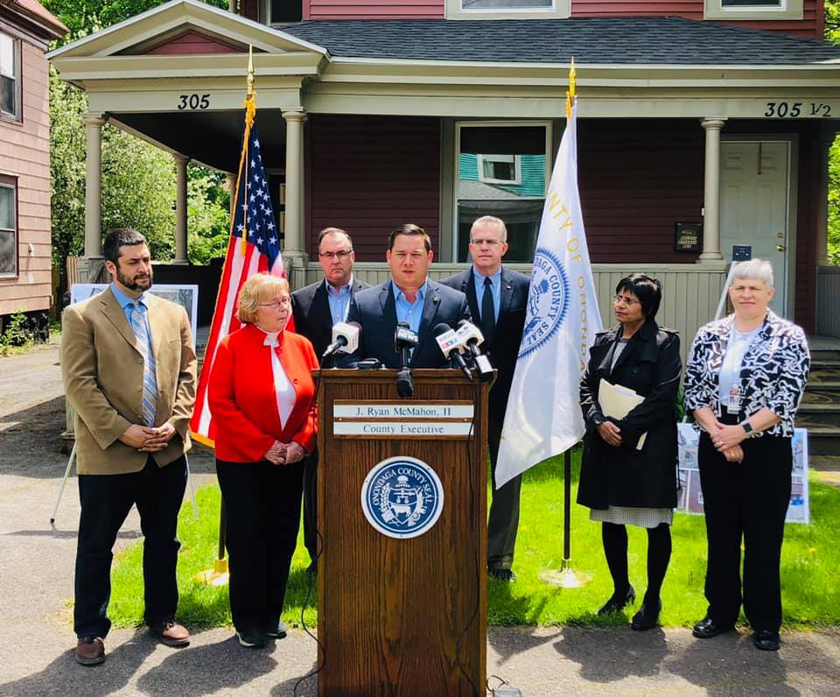
Tackling Lead

Slide 16
Tackling Lead
$5.6M (OC 2020)
$4.1M (City 2019)
$4.5M (City 2022)
$3.7M (OC 2022)
+
$5M (OC 2023 proposed)
$18.4M

Slide 17
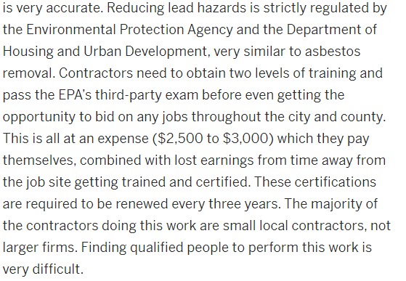
Tackling Lead

Slide 18
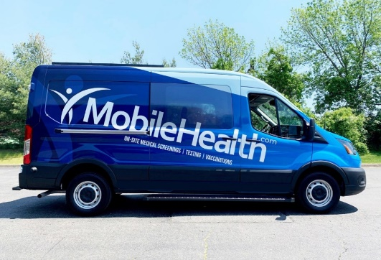
Tackling Lead
·Build Local Capacity
·Support Recruitment Drives
·Assist with HUD & EPA Fees
·Train Existing Contractors
·Upgrade Outdated Equipment
·Mobile Lead Testing Van

Slide 19
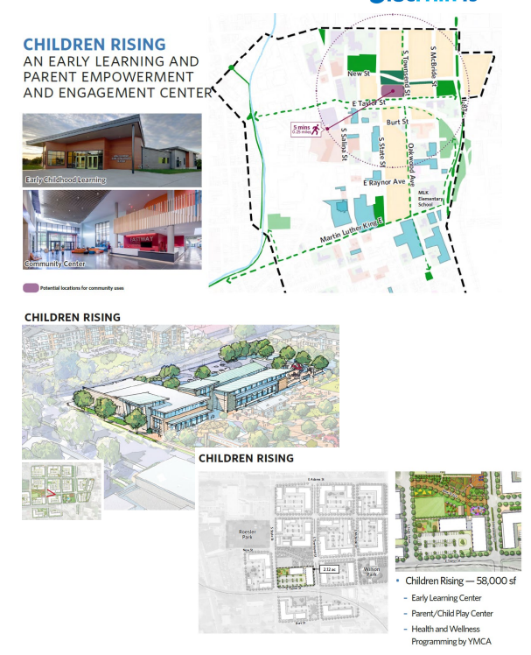
Investing In Our Youth
$5M

Slide 20
Children’s Rising Center
·Vital to 15th Ward Transformation
·Early Learning Center
·Parent/Child Play Center
·YMCA
·ECA Headquarters
·Offer Programs & Services to Promote Positive Youth Development

Slide 21
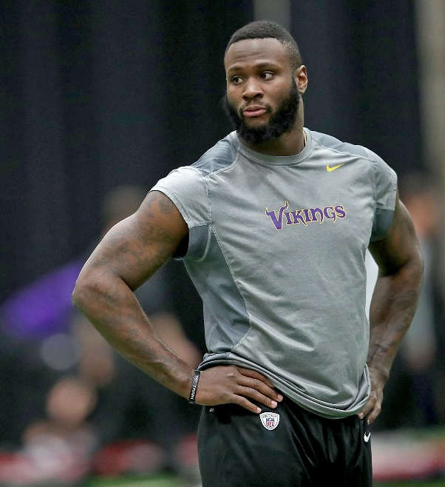
Investing In Our Youth
John Diaz Community Center
$2M

Slide 22
Investing In Our Youth
$2.3M

Slide 23
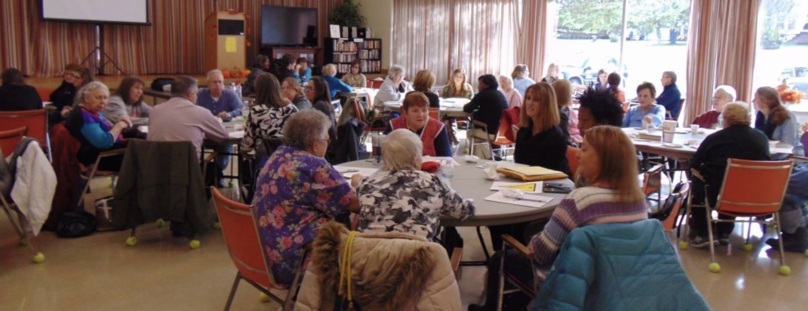
Investing In Our Seniors
$1M

Slide 24
Investing In
Public Safety
$750,000
Adds Deputy Sheriff Positions
Funds School Resource Officers

Slide 25
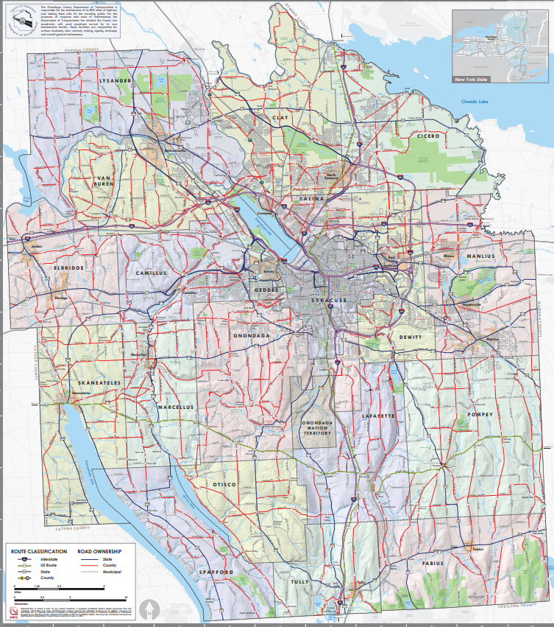
Investing In Our Infrastructure
County Owned Roads in Red
$10M

Slide 26
Planning & Preparing
$500,000

Slide 27
Planning & Preparing
·Examine Impacts of Viaduct Removal
·Propose Mitigation Strategies & Recommendations
·Potential New Opportunities for Impacted Communities

Slide 28
Investing In Our Main Streets
·$9.45M County Investment
·Leveraged $10.3M in Private Investment
·Continue Momentum with $5M more in 2023

Slide 29
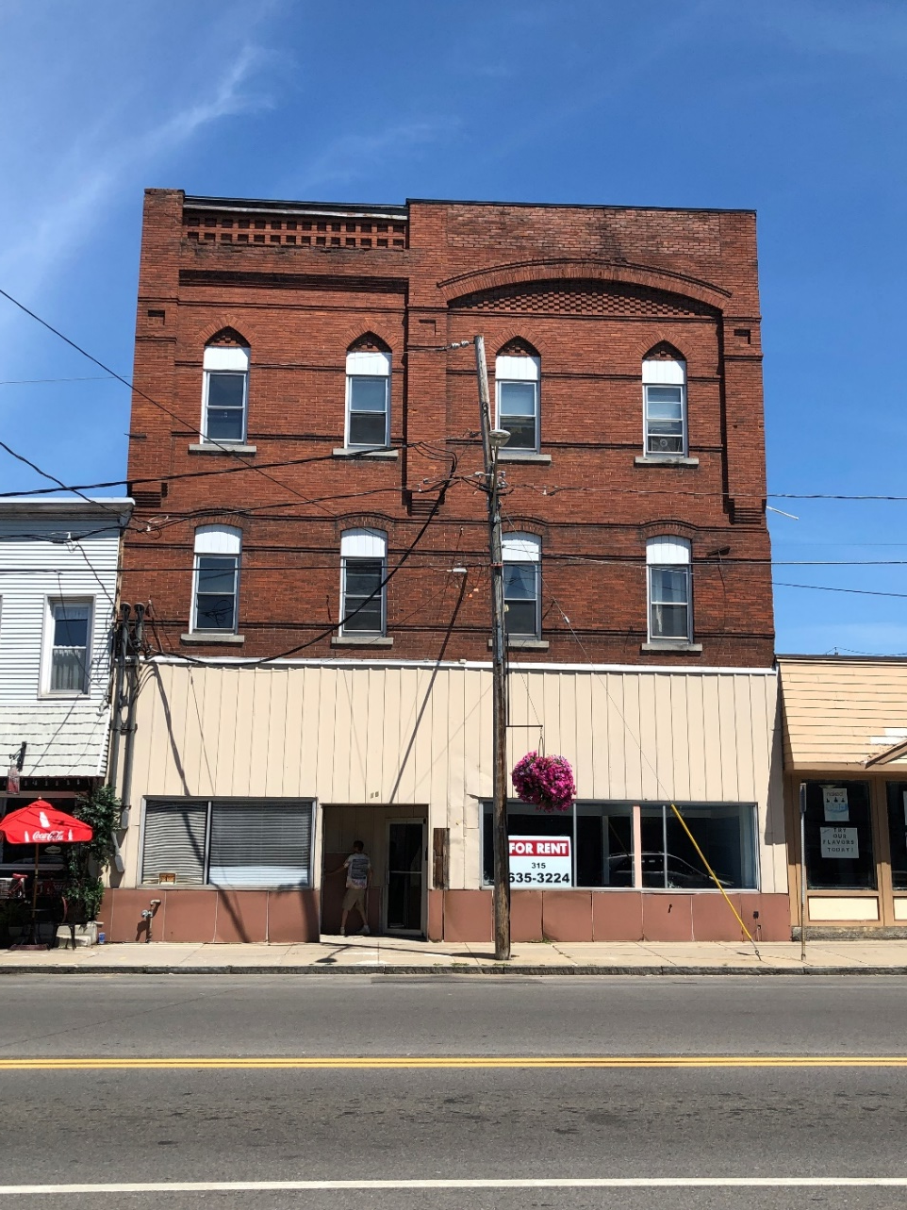
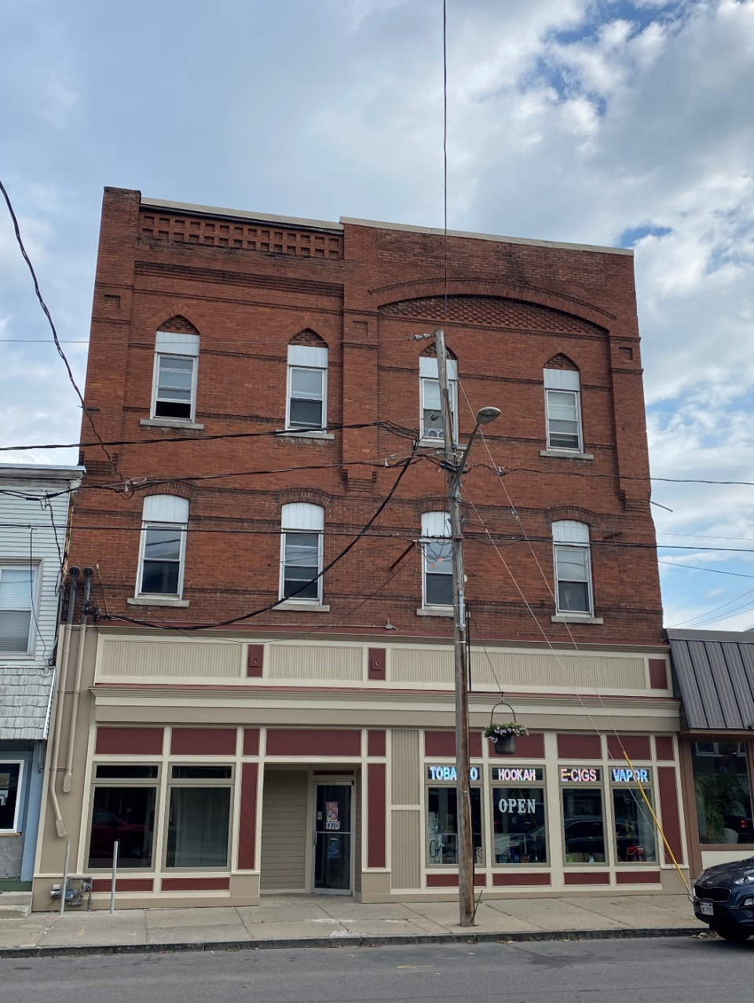
Before
After
Baldwinsville

Slide 30
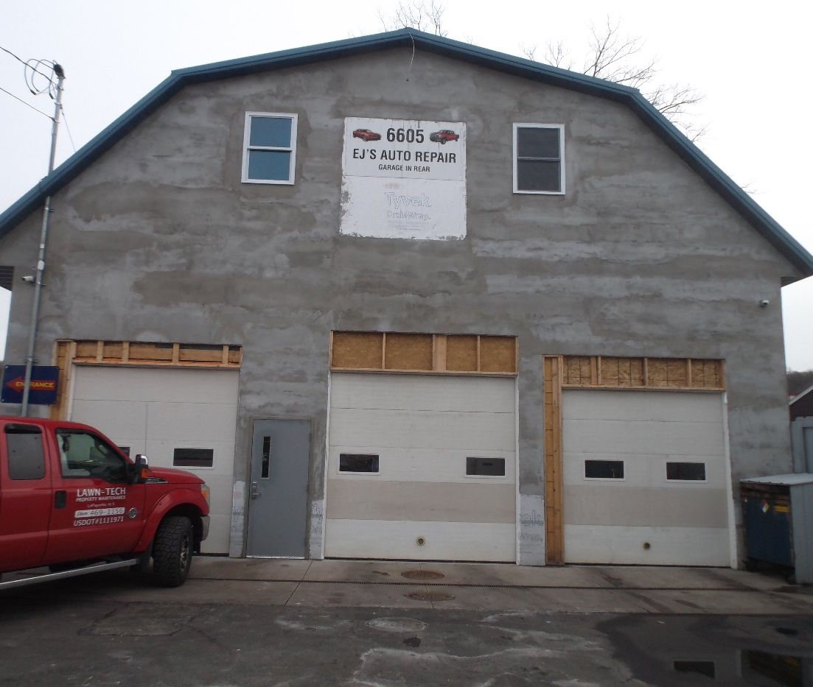
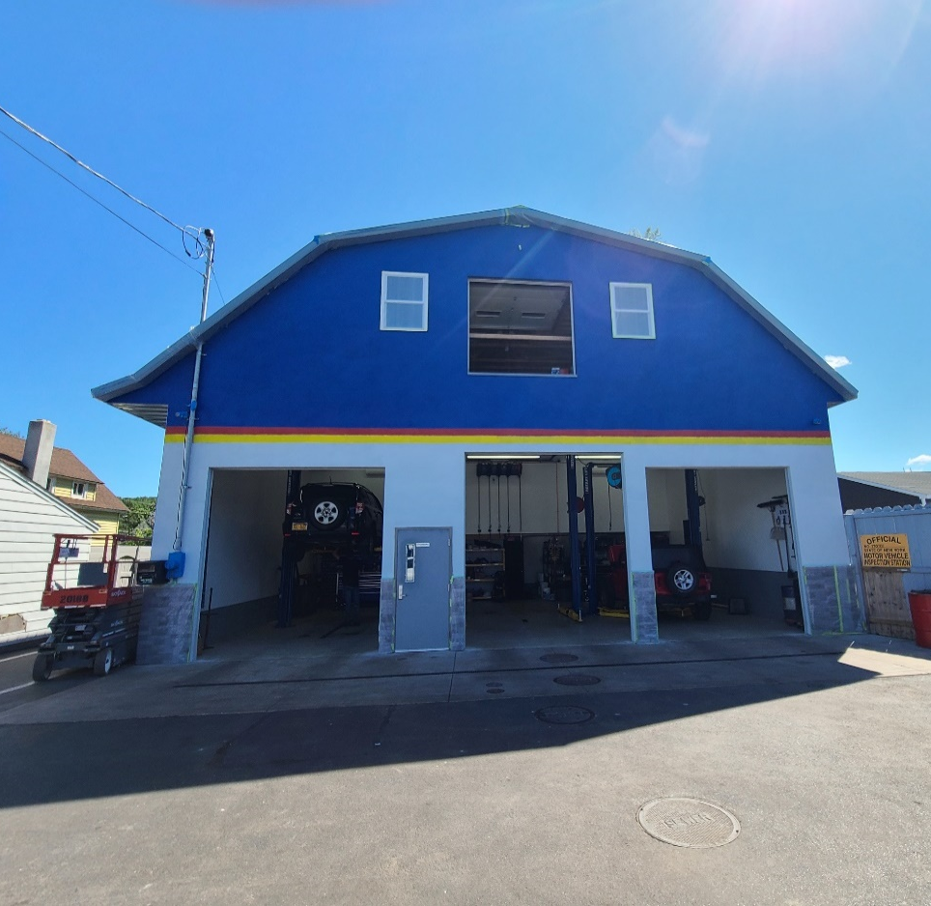
Before
After
Nedrow

Slide 31
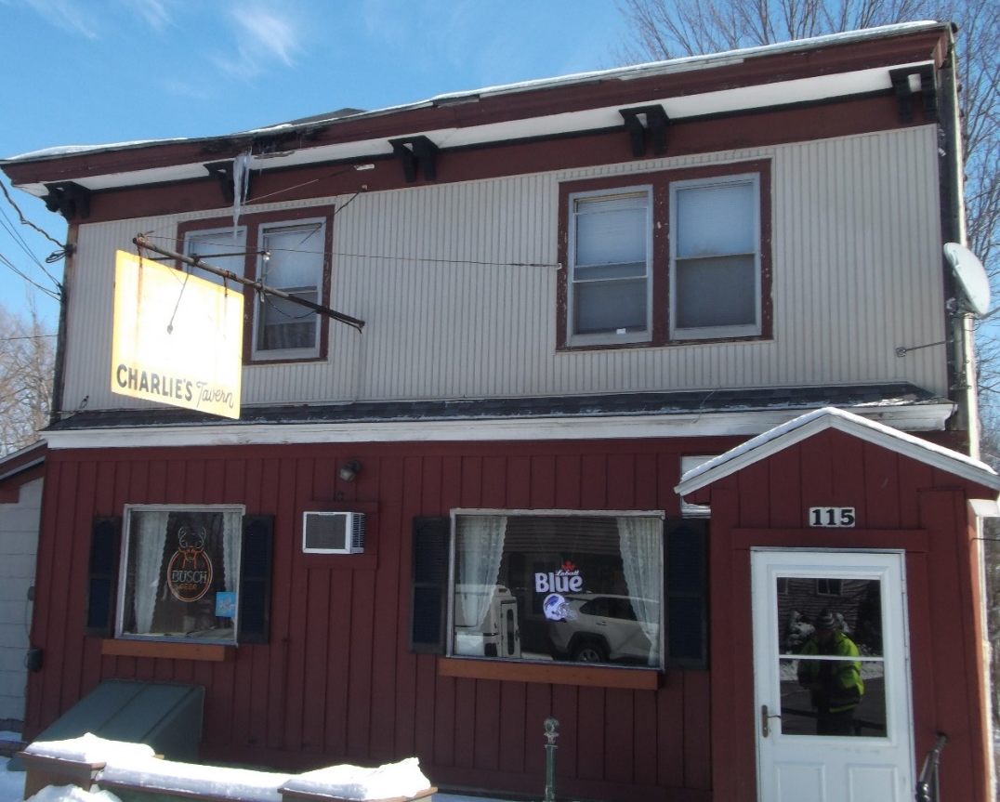
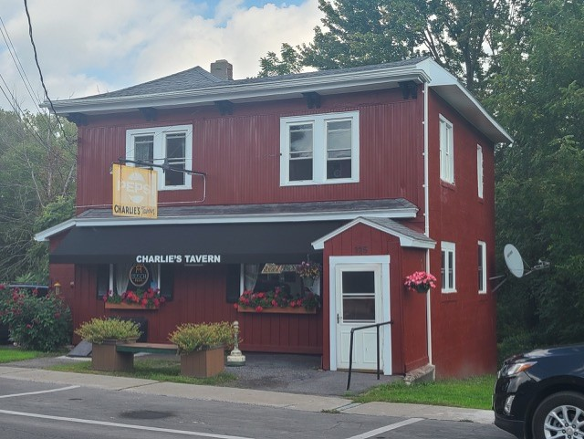
Before
After
Minoa

Slide 32
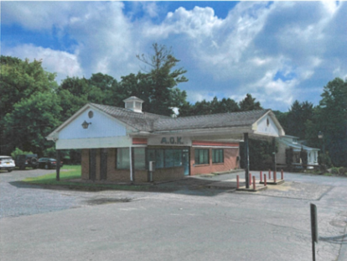
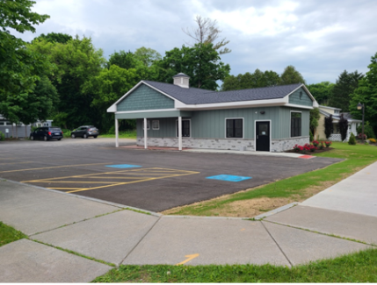
Before
After
Marcellus

Slide 33
2023 Executive Budget Presentation
J. Ryan McMahon, II, County Executive
Thursday, September 15th, 2022

